Slide 1
Decision Tree implementation Example#2
Dr. Kavita S. Oza

Slide 2
Pima Indians Diabetes Database
The Pima Indians Diabetes dataset contains medical information for 768 women from the Pima Indian population near Phoenix, Arizona, USA.
The primary objective of this dataset is to predict whether or not a patient has diabetes

Slide 3
Dataset
# 1. Number of times pregnant
# 2. Plasma glucose concentration a 2 hours in an oral glucose tolerance test
# 3. Diastolic blood pressure (mm Hg)
# 4. Triceps skin fold thickness (mm)
# 5. 2-Hour serum insulin (mu U/ml)
# 6. Body mass index (weight in kg/(height in m)^2)
# 7. Diabetes pedigree function
# 8. Age (years)
# 9. Class variable (0 or 1)

Slide 4

Pima Indian Diabetes Dataset

Slide 5
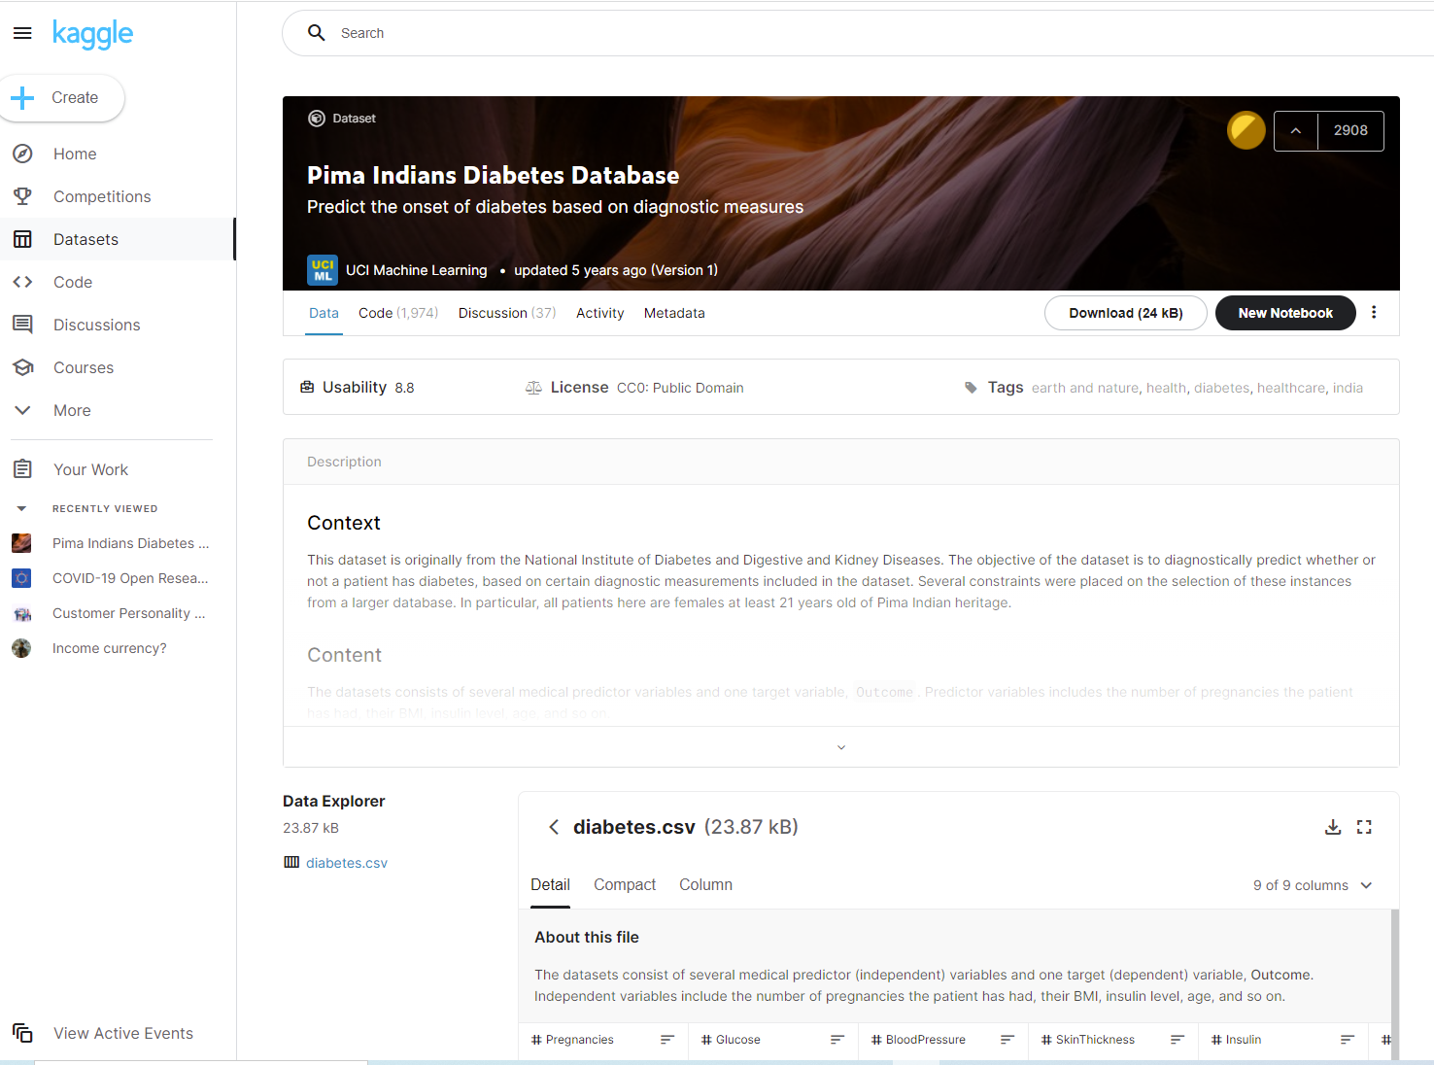
Pima Indian Diabetes Dataset…

Slide 6
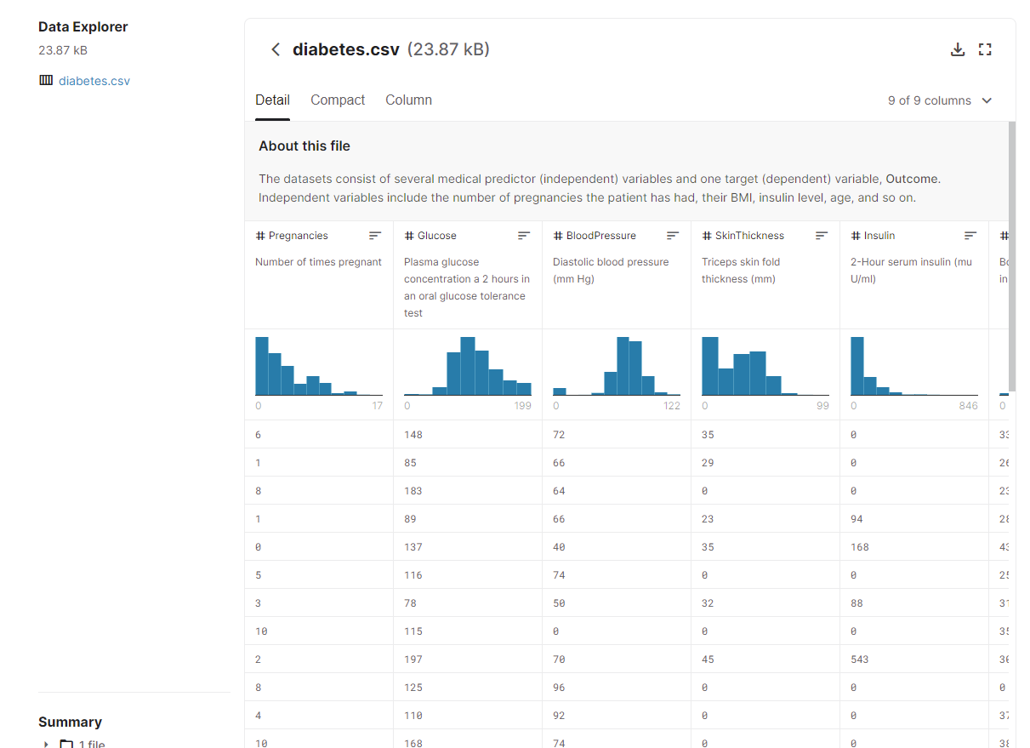
Download diabetes.csv

Slide 7
import the libraries
import numpy as np
import pandas as pd
from sklearn.model_selection import train_test_split # Import train_test_split
function
from sklearn.tree import DecisionTreeClassifier # Import Decision Tree Classifier
from sklearn.metrics import accuracy_score #Import scikit-learn metrics module for
accuracy calculation
from sklearn import tree
import matplotlib.pyplot as plt
import seaborn as sns
from sklearn.metrics import classification_report, confusion_matrix

Slide 8
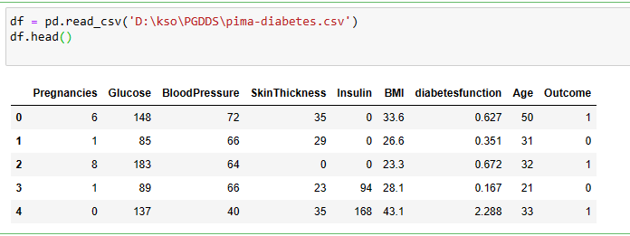
Loading Data
Load the required Pima Indian Diabetes dataset using pandas' read CSV function
#reading the data
df = pd.read_csv('D:\kso\PGDDS\pima-diabetes.csv')
df.head()

Slide 9
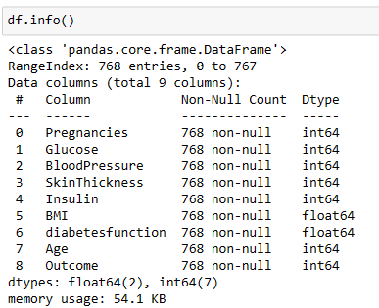
#Getting information of dataset
df.info()
No. of Rows and Columns
df.shape
(768, 9)

Slide 10
Separating attributes and class label
Separate the independent and dependent variables using the slicing method.
x=df.values[:, 0:8]
print(x)
Separating attributes
[[ 6. 148. 72. ... 33.6 0.627 50. ]
[ 1. 85. 66. ... 26.6 0.351 31. ]
[ 8. 183. 64. ... 23.3 0.672 32. ]
...
[ 5. 121. 72. ... 26.2 0.245 30. ]
[ 1. 126. 60. ... 30.1 0.349 47. ]
[ 1. 93. 70. ... 30.4 0.315 23. ]]

Slide 11
Separating attributes and class label…
#Separating class Label
y=df.values[:,8]
print(y)
[1. 0. 1. 0. 1. 0. 1. 0. 1. 1. 0. 1. 0. 1. 1. 1. 1. 1. 0. 1. 0. 0. 1. 1.
1. 1. 1. 0. 0. 0. 0. 1. 0. 0. 0. 0. 0. 1. 1. 1. 0. 0. 0. 1. 0. 1. 0. 0.
1. 0. 0. 0. 0. 1. 0. 0. 1. 0. 0. 0. 0. 1. 0. 0. 1. 0. 1. 0. 0. 0. 1. 0.
1. 0. 0. 0. 0. 0. 1. 0. 0. 0. 0. 0. 1. 0. 0. 0. 1. 0. 0. 0. 0. 1. 0. 0.
0. 0. 0. 1. 1. 0. 0. 0. 0. 0. 0. 0. 0. 1. 1. 1. 0. 0. 1. 1. 1. 0. 0. 0.
1. 0. 0. 0. 1. 1. 0. 0. 1. 1. 1. 1. 1. 0. 0. 0. 0. 0. 0. 0. 0. 0. 0. 1.
0. 0. 0. 0. 0. 0. 0. 0. 1. 0. 1. 1. 0. 0. 0. 1. 0. 0. 0. 0. 1. 1. 0. 0.
0. 0. 1. 1. 0. 0. 0. 1. 0. 1. 0. 1. 0. 0. 0. 0. 0. 1. 1. 1. 1. 1. 0. 0.
1. 1. 0. 1. 0. 1. 1. 1. 0. 0. 0. 0. 0. 0. 1. 1. 0. 1. 0. 0. 0. 1. 1. 1.
1. 0. 1. 1. 1. 1. 0. 0. 0. 0. 0. 1. 0. 0. 1. 1. 0. 0. 0. 1. 1. 1. 1. 0.
0. 0. 1. 1. 0. 1. 0. 0. 0. 0. 0. 0. 0. 0. 1. 1. 0. 0. 0. 1. 0. 1. 0. 0.
1. 0. 1. 0. 0. 1. 1. 0. 0. 0. 0. 0. 1. 0. 0. 0. 1. 0. 0. 1. 1. 0. 0. 1.
0. 0. 0. 1. 1. 1. 0. 0. 1. 0. 1. 0. 1. 1. 0. 1. 0. 0. 1. 0. 1. 1. 0. 0.
1. 0. 1. 0. 0. 1. 0. 1. 0. 1. 1. 1. 0. 0. 1. 0. 1. 0. 0. 0. 1. 0. 0. 0.
0. 1. 1. 1. 0. 0. 0. 0. 0. 0. 0. 0. 0. 1. 0. 0. 0. 0. 0. 1. 1. 1. 0. 1.
1. 0. 0. 1. 0. 0. 1. 0. 0. 1. 1. 0. 0. 0. 0. 1. 0. 0. 1. 0. 0. 0. 0. 0.
0. 0. 1. 1. 1. 0. 0. 1. 0. 0. 1. 0. 0. 1. 0. 1. 1. 0. 1. 0. 1. 0. 1. 0.

Slide 12
Splitting for training and testing
x_train, x_test, y_train, y_test = train_test_split(x, y, test_size=0.2, random_state=10)
Creating decision tree object
clf_entropy= DecisionTreeClassifier(criterion ="entropy",
random_state=100, max_depth=3, min_samples_leaf=5)
Training decision tree
clf_entropy.fit(x_train, y_train)
DecisionTreeClassifier(class_weight=None, criterion='entropy', max_depth=3,
max_features=None, max_leaf_nodes=None,
min_impurity_decrease=0.0, min_impurity_split=None,
min_samples_leaf=5, min_samples_split=2,
min_weight_fraction_leaf=0.0, presort=False, random_state=100,
splitter='best')

Slide 13
Testing Decision tree model
y_pred_en=clf_entropy.predict(x_test)
y_pred_en
array([0., 0., 0., 0., 0., 0., 0., 0., 0., 0., 0., 0., 1., 0., 0., 1., 1.,
0., 0., 1., 0., 0., 0., 0., 0., 1., 0., 0., 0., 1., 0., 0., 0., 0.,
0., 0., 0., 0., 1., 0., 0., 0., 0., 0., 0., 0., 0., 0., 0., 0., 0.,
1., 0., 0., 0., 0., 0., 0., 0., 0., 0., 0., 0., 0., 0., 0., 1., 0.,
0., 0., 1., 0., 0., 0., 0., 0., 1., 1., 0., 0., 0., 1., 0., 0., 0.,
0., 0., 0., 0., 0., 0., 0., 0., 0., 0., 0., 1., 0., 0., 0., 0., 0.,
0., 0., 0., 0., 1., 0., 0., 0., 0., 0., 0., 0., 0., 0., 0., 0., 0.,
0., 0., 0., 0., 0., 0., 0., 0., 0., 0., 0., 0., 0., 0., 0., 0., 0.,
0., 0., 1., 0., 0., 0., 0., 0., 1., 0., 0., 0., 1., 0., 0., 0., 0.,
0.])

Slide 14
Check accuracy
print(("Accuracy is :"), accuracy_score(y_test, y_pred_en)*100)
Accuracy is : 69.48051948051948
#Visualizing tree
from sklearn.tree import export_graphviz
from sklearn.externals.six import StringIO
from IPython.display import Image
import pydotplus
dot_data = StringIO()
export_graphviz(clf_entropy, out_file=dot_data,
filled=True, rounded=True,
special_characters=True)
graph = pydotplus.graph_from_dot_data(dot_data.getvalue())
graph.write_png('diabetes.png')
Image(graph.create_png())

Slide 15
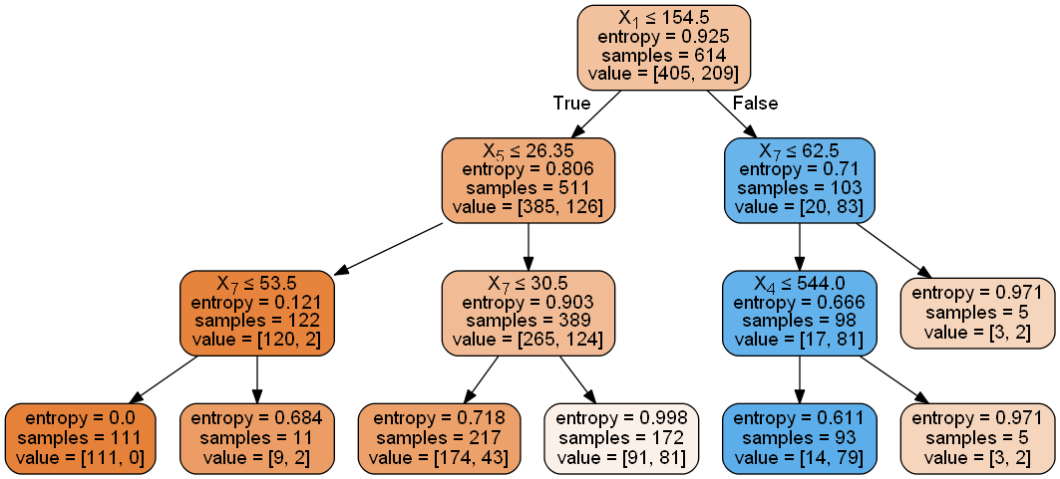
diabetes.png

Slide 16
Graph with labels
print(list(df))
features=['Pregnancies', 'Glucose', 'BloodPressure', 'SkinThickness',
'Insulin', 'BMI', 'DiabetesPedigreeFunction', 'Age']
dot_data = StringIO()
export_graphviz(clf_entropy, out_file=dot_data, filled=True, rounded=True,
special_characters=True, feature_names = features,
class_names=['0','1'])
graph = pydotplus.graph_from_dot_data(dot_data.getvalue())
graph.write_png('diabetes.png')
Image(graph.create_png())
['Pregnancies', 'Glucose', 'BloodPressure', 'SkinThickness', 'Insulin', 'BMI', 'DiabetesPedigreeFunction', 'Age', 'Outcome']

Slide 17
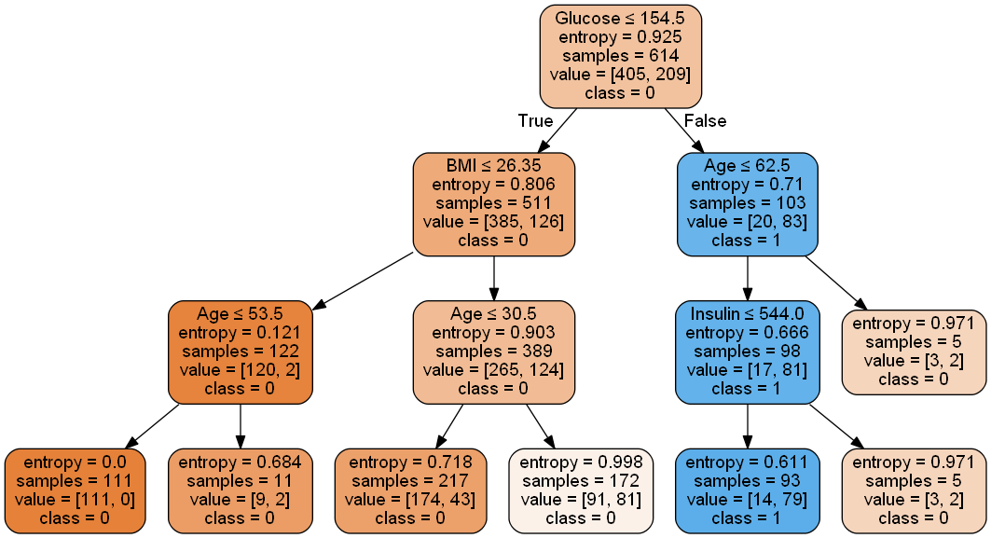
Graph with attribute names

Slide 18
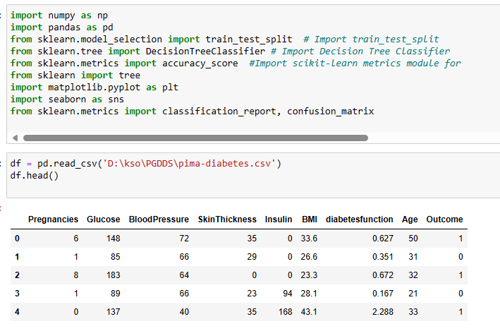
Program at a glance

Slide 19
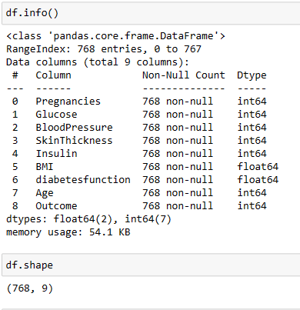
Program at a glance

Slide 20
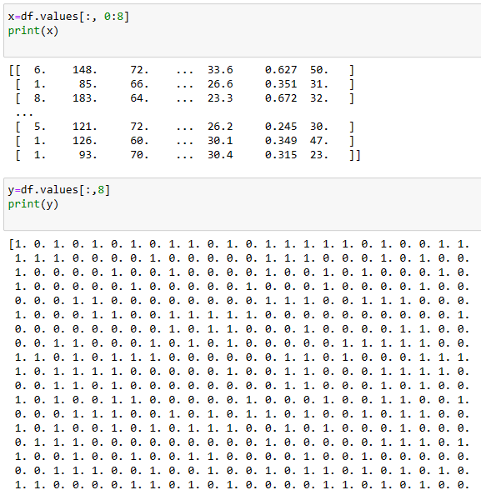
Program at a glance

Slide 21
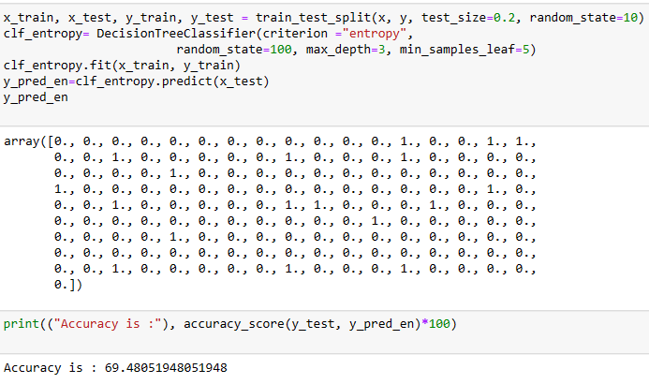
Program at a glance

Slide 22
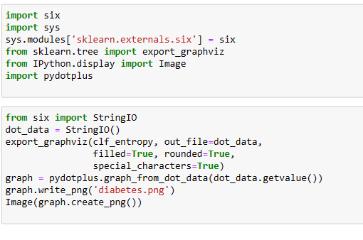
Program at a glance

Slide 23
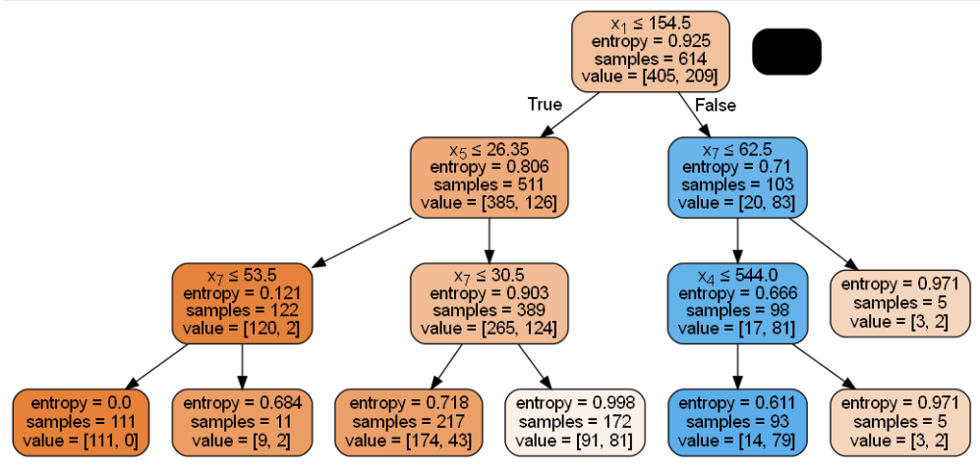
Program at a glance

Slide 24
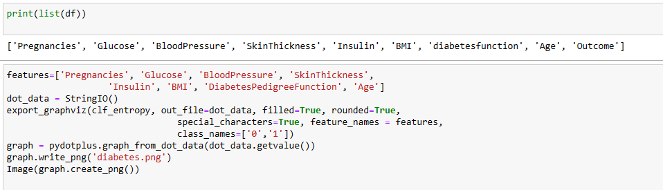
Program at a glance

Slide 25
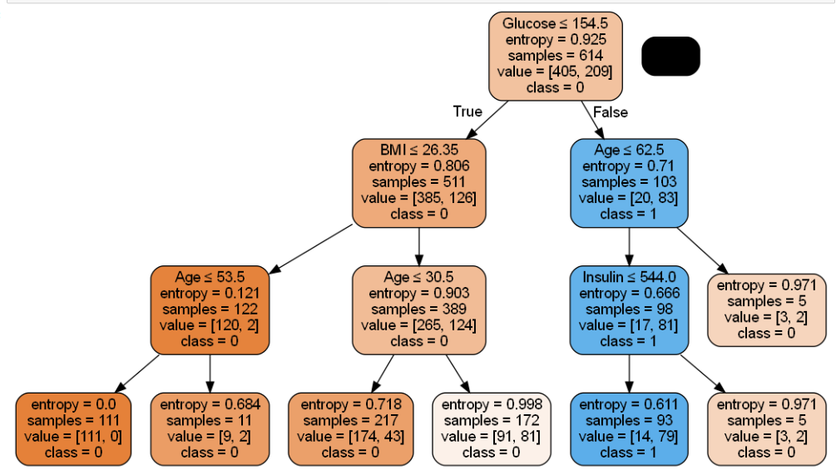
Program at a glance

Slide 26
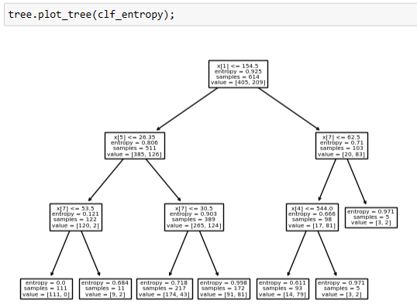
Program at a glance

Slide 27
Thank You

